Slide 1
Notes:
#094780 -Blue colour
#C7B8E7 – light grey #E6E6E6 b5c8d7 e2f4ed
#118DFF – light blue

Slide 2
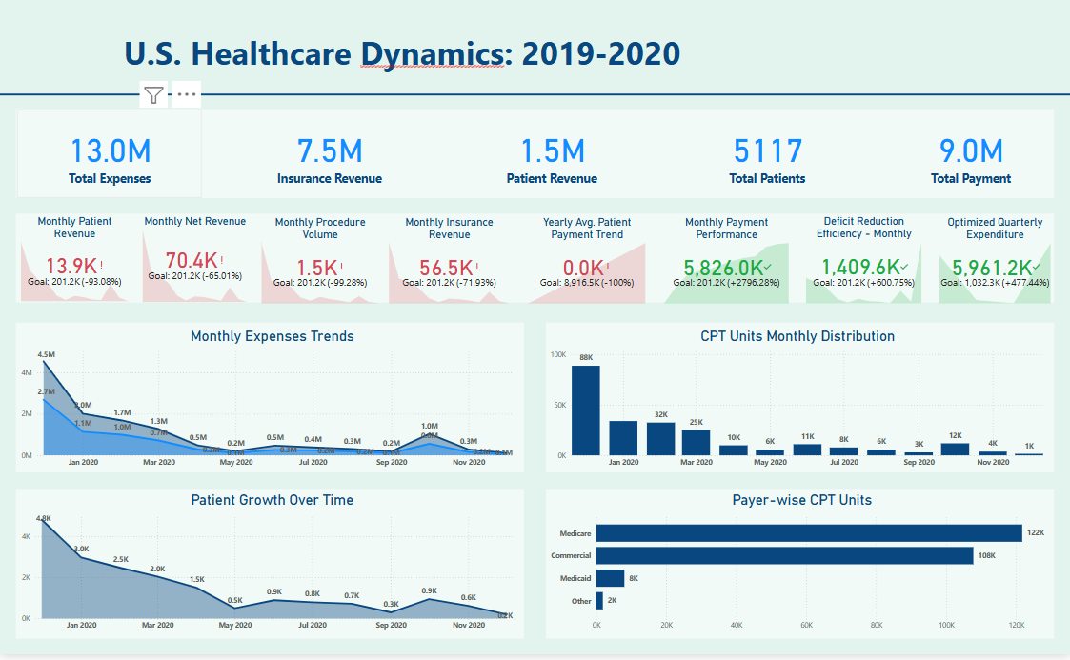

Notes:
#094780 -Blue colour
#C7B8E7 – light grey #E6E6E6 b5c8d7 e2f4ed
#118DFF – light blue

Slide 3
Notes:
#094780 -Blue colour
#C7B8E7 – light grey #E6E6E6 b5c8d7 e2f4ed
#118DFF – light blue

Slide 4
Notes:
#094780 -Blue colour
#C7B8E7 – light grey #E6E6E6 b5c8d7 e2f4ed
#118DFF – light blue

Slide 5
Notes:
#094780 -Blue colour
#C7B8E7 – light grey #E6E6E6 b5c8d7 e2f4ed
#118DFF – light blue

